Slide 1
SUPPORTING SUSTAINABLE
RANGELAND MANAGEMENT
ETHIOPIA

Slide 2
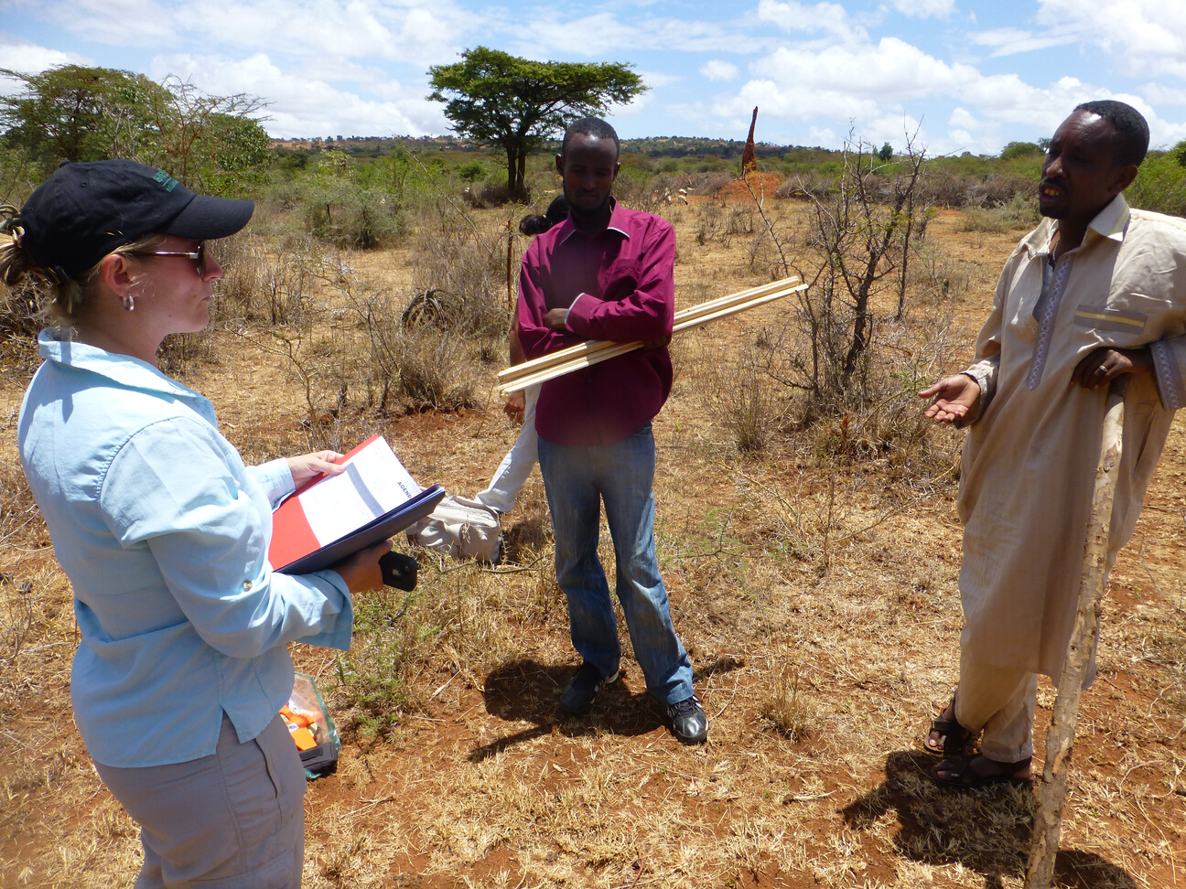
OVERVIEW
The U.S. Forest Service has been active in Ethiopia since 2005
WE OFFER RANGELAND MANAGEMENT TECHNICAL ASSISTANCE IN :
Rangeland planning
GIS mapping
Monitoring
Prescribed burning
Fire ecology
Invasive species management
Payment for ecosystem services
Land cover and land use assessments
International exchange
WE SUPPORT THE:
USAID Pastoral Livelihoods Initiative (PLI) program 1: (2005 - 2008) and II: (2008 - 2013)
USAID Pastoralist Areas Resilience Improvement and Market Expansion (PRIME) program (2013 - 2018)
USAID Resilience in Pastoral Areas (RiPA) program (2020-present)

Slide 3
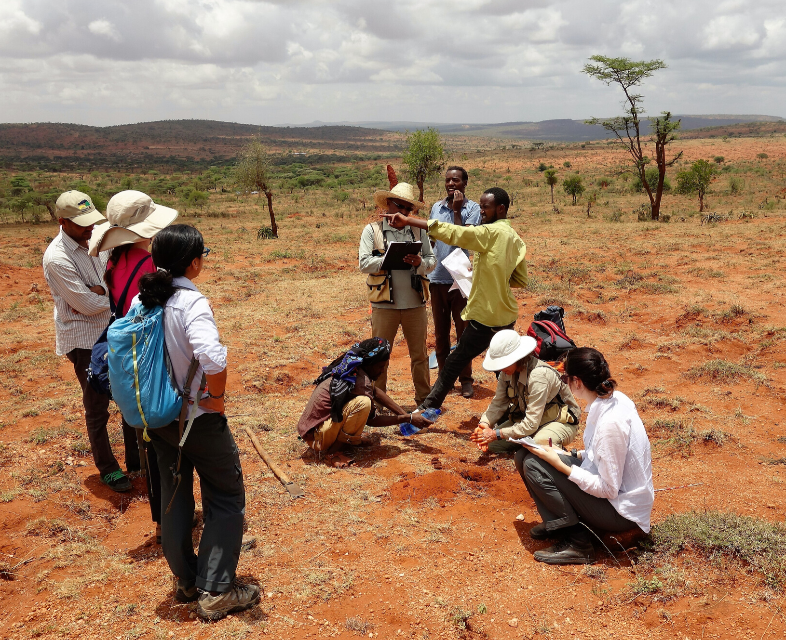
PARTNERSHIPS
WE PARTNER WITH:
USAID/Ethiopia and the US Embassy in Addis Ababa
The Government of Ethiopia
International NGOs (CARE, MercyCorps, PCI, ILRI)
The Yabello Research Station
Dryland Agriculture Research Center
Colorado State University
Environmental Systems Research Institute
Wondo Genet University

Slide 4
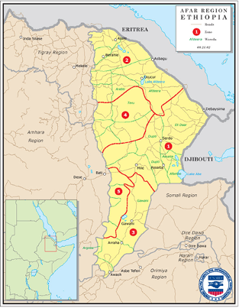
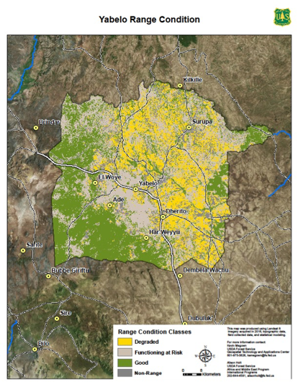
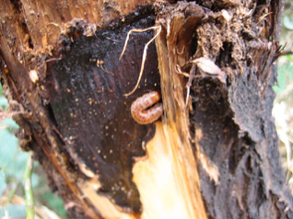
EXAMPLES OF OUR WORK
Introduction of new data collection technology
Mobile application for the Land Potential Knowledge System (LandPKS), which is now becoming an international standard in Africa
Online database for ArcGIS
Rangeland monitoring and GIS mapping
Regional land use / land cover maps for grazing areas in Borana, Afar, Somali and Guji (about 20,000 ha each).
Established a long-term vegetation monitoring baseline
Invasive species management
Developed a manual for Prosopis juliflora control in important pastoral areas

Slide 5
EDUCATION OPPORTUNITIES
Professional and Educational Development
2
11 Ethiopian participants in the annual USFS livestock grazing management seminar in Idaho
Technical Exchanges
Research
1
3
20+ USFS technical exchange missions to Ethiopia that resulted in improved rangeland management and planning; and intensive field training in range monitoring, GIS and data management
5 Ethiopian Master’s degree scholarships to support sustainable natural resource management

Slide 6
OUTCOMES
Capacity built
Local and partner capacity built in monitoring, GIS and data management.
149 monitoring plots established in Afar, Somali, Guji and Borana
Tools for advocacy
Pastoral communities in four areas of Ethiopia now have a series of map products to help them advocate for land rights policies, particularly land use certification
Learning materials
A biodiversity handbook for the Borana zone of Ethiopia that includes important rangeland species. The field guide is translated in English and Oromiffa
Comprehensive rangeland management plans
Over 340,000 hectares of land are under stronger community management

Slide 7
NEXT STEPS for DISCUSSION
Continue to build capacity and raise awareness of fire and invasive species management.
Identify concrete training opportunities and outcomes to build skills of local personnel and partners.
Build on previously-developed range monitoring capacity through implementation of adaptive management with local range management communities.
Work with new partners to expand GIS, mapping and rangeland monitoring capability.
Build on successes with rangeland planning through implementation and adaptive management. For example, apply simplified methods for communicating considerations of timing, duration and intensity of livestock use on rangelands.
Continued education and development: support former participants of the USFS International Seminar on Livestock Grazing Management and continue to conduct range schools across Ethiopia.
Develop a briefing presentation or paper on range school principles to be presented to senior government officials.

Slide 8
NEXT STEPS for RANGELAND MANAGEMENT COLLABORATION
Continue to collect rangeland health field data in pilot areas to assess success of community-led grazing management.
Build consensus and accountability to strengthen monitoring with range councils.
Identify local capacity for range monitoring/adaptive management and provide them with training.
Integrate program activities with range management plan objectives.
Promote cooperation and coordination between local government and range councils.
Monitor implementation of range management plans to ascertain range trend and treatment effects.
Develop reporting structure for local monitoring personnel.

Slide 9
U.S. Forest Service Ethiopia Program Contact Information:
Natasha Marwah Kristina Bell
Deputy Regional Director, Africa and Middle East Africa and Middle East Program Manager
USFS International Programs USFS International Programs
Natasha.Marwah@usda.gov Kristina.Bell@usda.gov
www.africaandmideast.internationalprograms.us

